Slide 1

Data Analysis
For Beginners
Nguyen Le – Database Officer SP25
IF MISSO, THEN SUCCESS!

Slide 2





A little bit about me…
Hinata Shoyo’s fan
As in BUSI2305, STAT3331, DB1, DB2
Statistics TA
Collaboration with Prof. Scamell
Pass the model training round of EY
3x Hackathons (1st ,1 Data Science)
Incoming Intern with Capgemini

Slide 3





Data Analysis Definition and Importance
What is data analysis?
Data analysis is the
process of inspecting,
cleaning, transforming,
and interpreting data to
extract useful insights,
support decision
making, and solve
problems
Important to business?
Informed Decision-Making
Pattern Identification
Efficiency & Optimization
Predictions & Forecasting
Competitive Advantage
Important to career?
High Demand
Better Job Opportunities
Enhanced Decision-Making Skills
Competitive Edge
Career Flexibility

Slide 4
What will we learn in this lesson?
01.
02.
03.
04.
Data Gathering
Gathering raw data for analysis
Data Cleaning
Preparing raw data for analysis
Data Exploratory Analysis
Understanding data through visualization and statistics
Data Modeling with Machine Learning
Using past and present data to predict outcomes

Slide 5

Data Gathering
01.
Gathering raw data for analysis

Slide 6
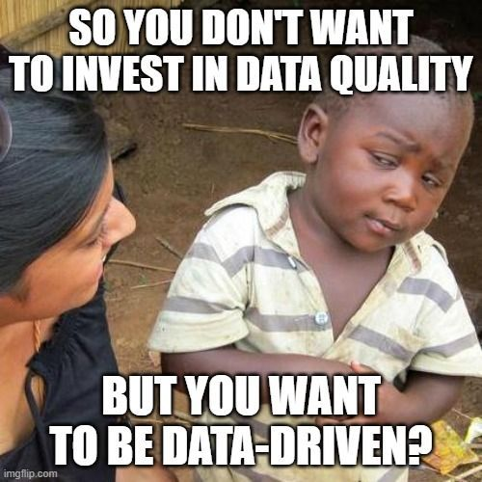

Data can come from different sources…
Database (SQL, NoSQL,…)
Cloud Storage (AWS, Azure,…)
Website: Web scraping
API
Surveys

Slide 7

Data Cleaning
02.
Preparing raw data for analysis

Slide 8
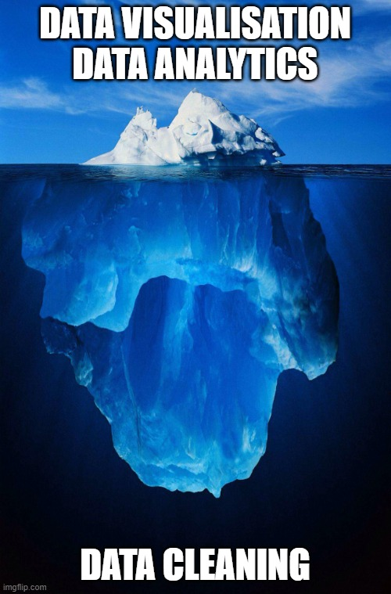

Data Cleaning
Definition
Data cleaning is the process of detecting, correcting, or removing errors and inconsistencies in raw data to improve its quality and usability for analysis.
VERY IMPORTANT!!!!
Data Analysts and Data Scientists spend 60% of time to clean data

Slide 9
Some common data issues
Missing Values – When data is incomplete (e.g., empty fields in a dataset).
Fill with mean/median (df.fillna(df.mean())) or remove rows (df.dropna()).
Duplicate Entries – When the same data appears multiple times.
Remove duplicates (df.drop_duplicates()).
Incorrect Data Types – Numbers stored as text, incorrect date formats.
Convert data types (df['date'] = pd.to_datetime(df['date'])).
Outliers – Unusual values that may distort analysis.
Identify with box plots and remove if necessary.
Inconsistent Formatting – Different representations of the same data (e.g., “NY” vs. “New York”).
Standardize text (df['city'] = df['city'].str.upper())

Slide 10
03.
Data Exploratory Analysis
Uncovering data through visualization and statistics

Slide 11
Data Exploratory Analysis
Exploratory Data Analysis (EDA) is the process of analyzing datasets to summarize their main characteristics, identify patterns, and detect anomalies using visualizations and statistics.
This is the foundation for your later machine-learning model -> DON’T SKIP THIS STEP
You can use statistics:
Mean, median, outliers, min, max, standard deviation,…
-> overview of the dataset
Correlation -> relationship between variables

Slide 12
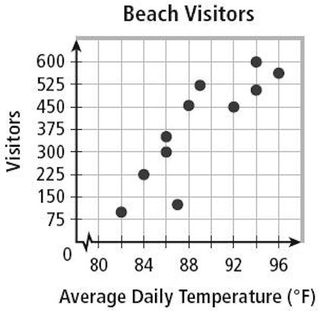
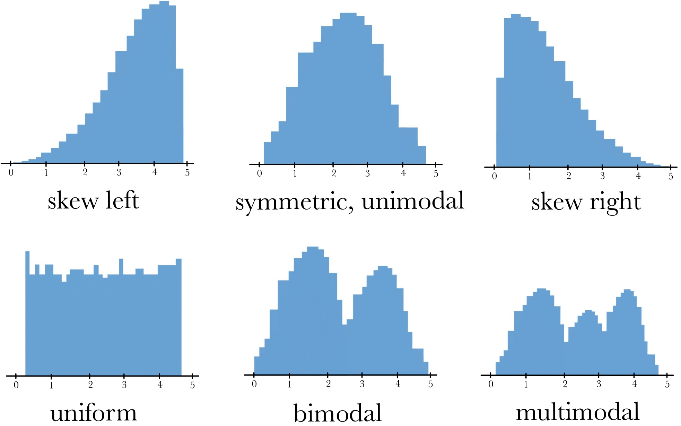
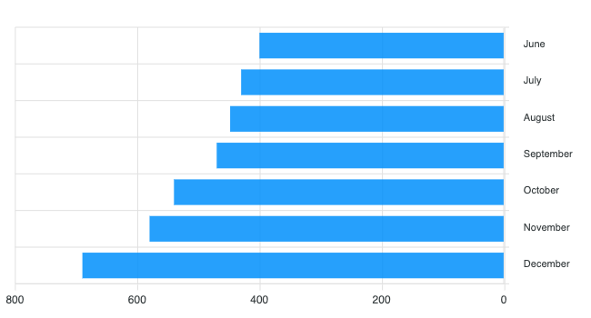
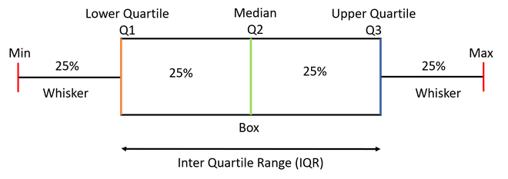
Data Exploratory Analysis
Scatter Plot
Histogram
Box Plot
Bar Chart

Slide 13
Data Modeling with Machine Learning
04.
Using past and present to predict outcomes

Slide 14
Terminology
Machine learning is a subset of Artificial Intelligence (AI) that enables computers to learn from data and make predictions without being explicitly programmed.
Supervised Learning: Trains models on labeled data to predict or classify new, unseen data.
Unsupervised Learning: Finds patterns or groups in unlabeled data, like clustering or dimensionality reduction.
Reinforcement Learning: Learns through trial and error to maximize rewards, ideal for decision-making tasks.

Slide 15
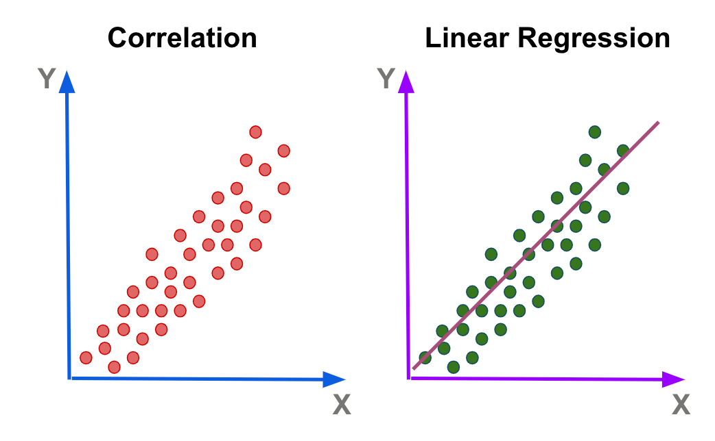
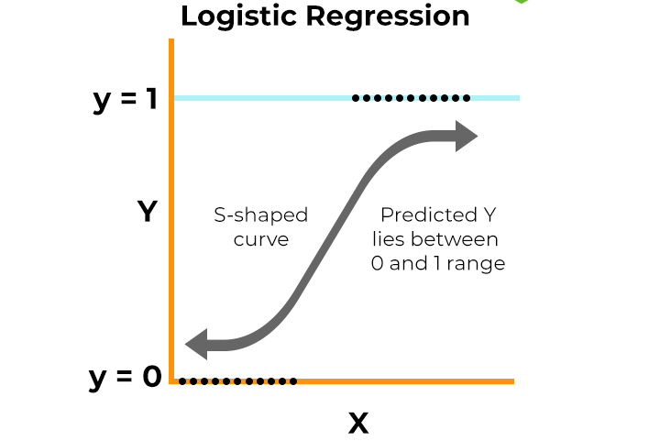

Supervised Learning
Regression: Predicts continuous values (e.g., house prices)
Algorithm: Linear Regression
Classification: Predicts categorical values(e.g., scam or not)
Algorithm: Logistic Regression, Decision Tree

Slide 16
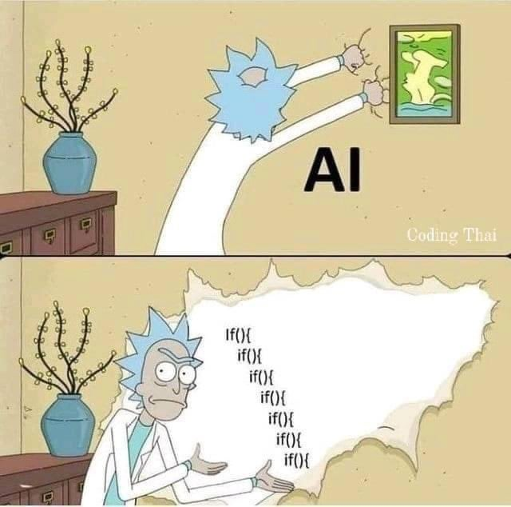
Build a ML Model from Scratch
Step 1: Do you need to use ML?
Can the rule be coded?
Can the prediction be drawn from the data?
Step 2: Feature Engineering
Change the categorical data to numeric data
Choose the variables in your model
Step 3: Choose the right model
Is it supervised or unsupervised?
Is it classification or regression?
Step 4: Split the data to training (80%) and test (20%)
Step 5: Train, evaluate and modify the model
- Avoid underfitting and overfitting

Slide 17
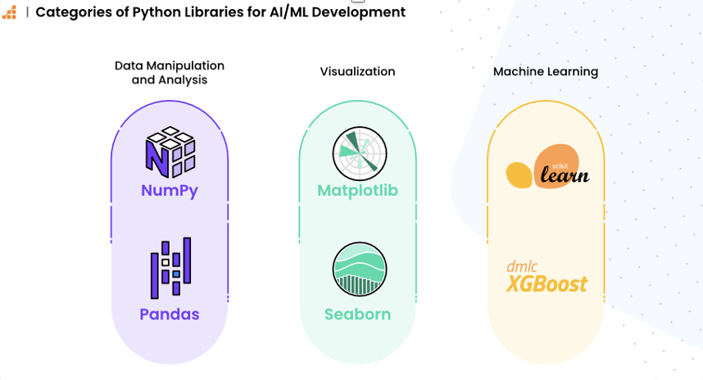
Popular Python Libraries

Slide 18
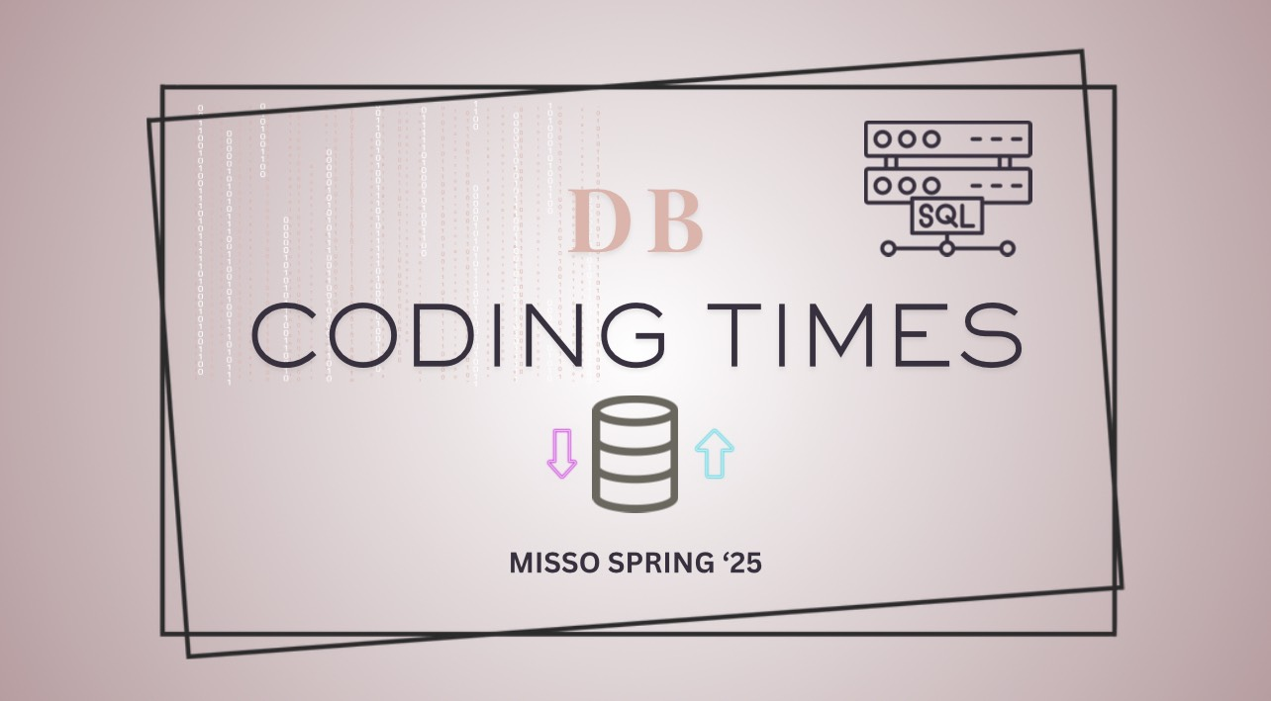

Slide 19

Using Google Collab to code
Step 1: Open Google Drive -> Create a folder -> Create a Google Collab Notebook
Step 2: Download the csv file and upload it to the folder
Step 3: Import the necessary library
Step 4: Load the data using read_csv
Step 5: Start to analyze

Slide 20


